Slide 1
Capstone Presentation
CUSTOMER CHURN PREDICTION
By
ISHAAN SHAKTI JAYARAMAN
PGPDSBA.O.JULY24.A

Slide 2
BUSINESS PROBLEM UNDERSTANDING

Slide 3

Introduction
Background:
The DTH company is struggling to retain existing accounts—a critical issue, as one account can represent multiple customers.
The Goal:
To proactively identify accounts at risk of churn and implement targeted, cost-effective retention campaigns that maximize customer lifetime value without compromising profitability.
The Problem:
High churn rates are causing significant customer and revenue loss. Traditional retention strategies are no longer sufficient.
This is a classification problem

Slide 4

Data Overview
Dataset Information:
Total Observations: 11,260 unique account IDs
Total Variables: 19 (18 independent + 1 dependent for churn classification)
Incorrect Entries: Significant number of null entries and irregular entries
Customer Information:
Demographics: Gender, Marital Status
Account Behavior: Monthly revenue, login device, churned, account users, payment method
Customer Service Interactions: Contact history, complaints, service scores
Engagement: Coupon usage, cashback usage

Slide 5
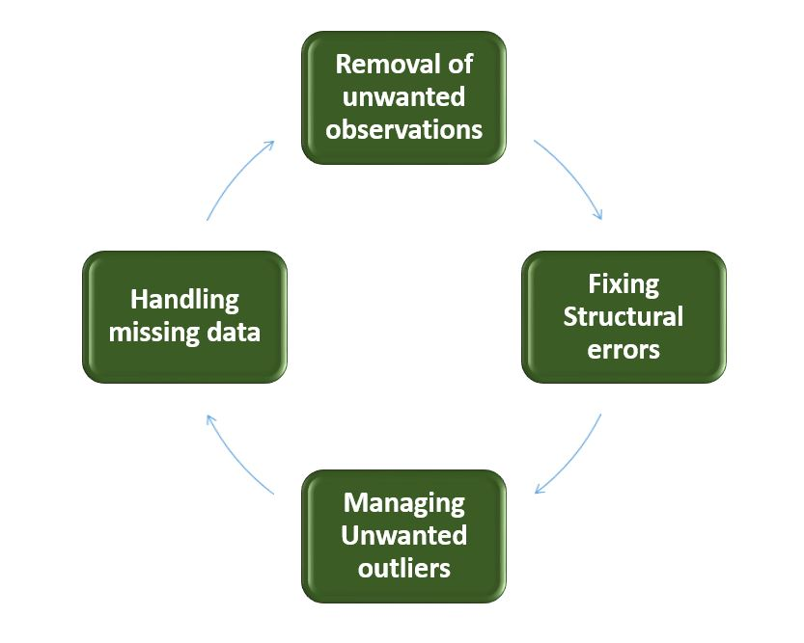
Data Cleanup
1. Variable Review and Invalid Entries
AccountID contains only unique values and will be removed after EDA.
Irregular entries (e.g., "$", "@", "&&&&") were replaced with NaN for uniform null value handling.
2. Null value Treatment:
Categorical Variables – imputed with Mode
Continuous Variables – imputed with Median

Slide 6
Data Cleanup
3. Outlier Treatment
Outliers were detected in multiple numerical variables.
Some variables like Churn and Service Score were excluded from treatment as values are genuine.
Continuous variables were handled using the IQR method, with extreme values capped at upper and lower bounds to reduce distortion.

Slide 7
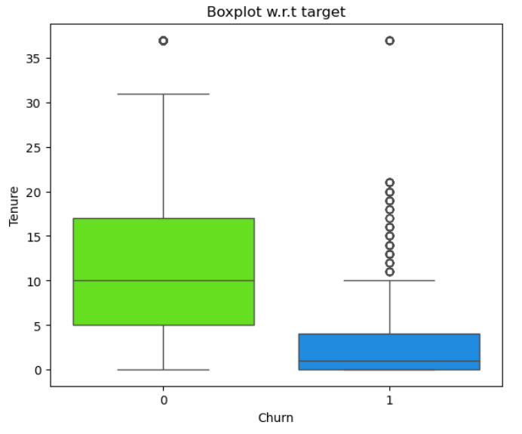
Exploratory Data Analysis
Customer Tenure against Churned Customers
Customers with shorter tenure have churned more than customers who have longer tenure.

Slide 8
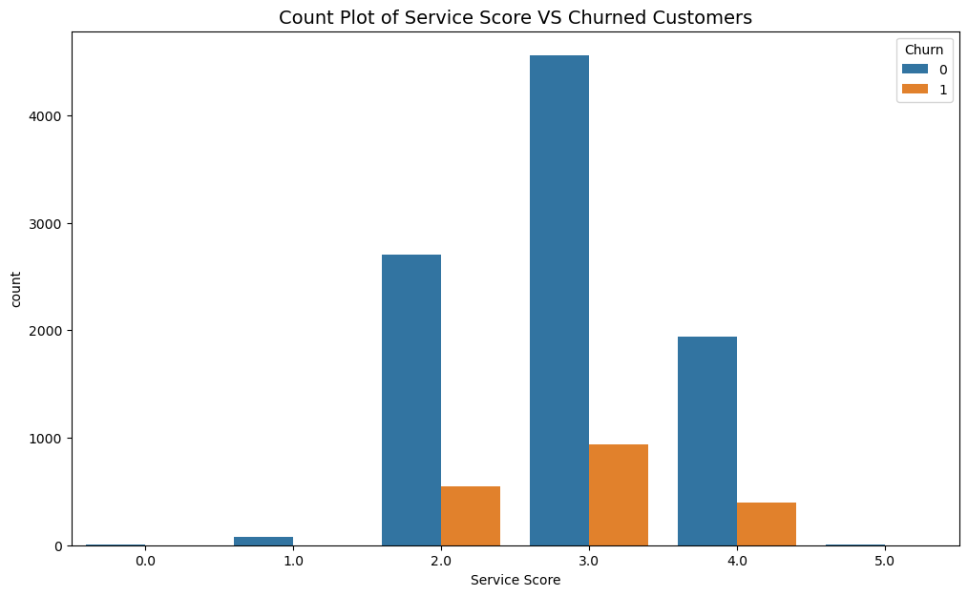
Exploratory Data Analysis
Service Score against Churned Customers
Service score rating of 3 is most common and has the highest number of churned customers indicating some dissatisfaction with the level of service.

Slide 9
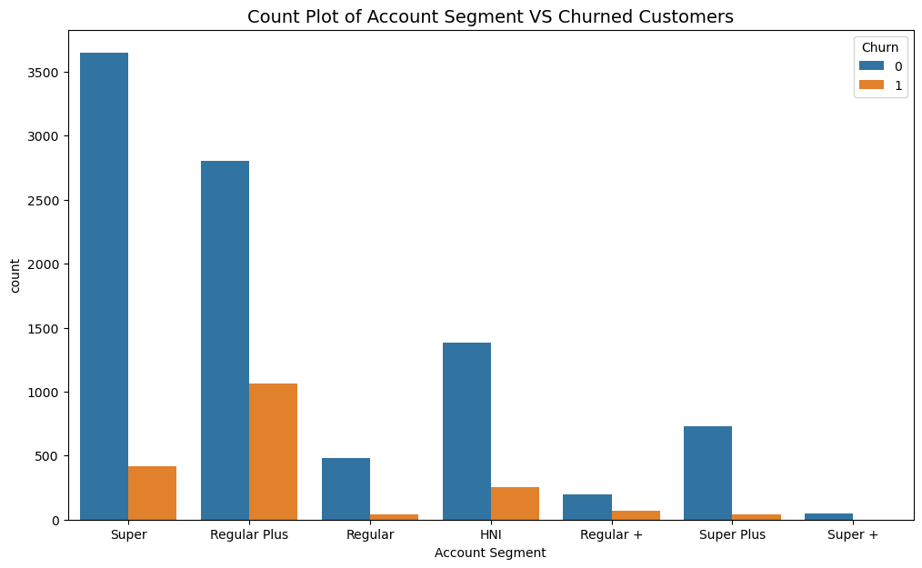
Exploratory Data Analysis
Account Segment against Churned Customers
Customers who are in the Regular Plus account segment have churned more compared to other segments.
Regular plus segment has the second highest number of total customers.

Slide 10
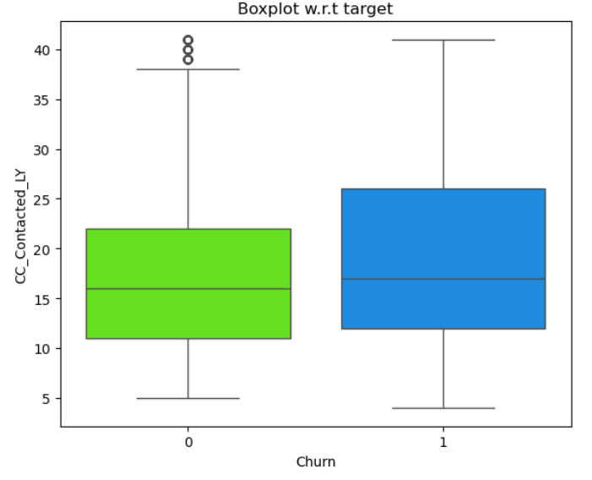
Exploratory Data Analysis
Customer Care Engagement against Churned Customers
Customers who have raised a complained in the last 12 months have a higher churn rate.

Slide 11
MODELING APPROACH USED & WHY

Slide 12




Modeling Approach
Preprocessing
Model Building
Model Evaluation
Encoded categorical variables to numerical format
Feature Selection using VIF
Scaled features using MinMaxScaler
Split data into 70% training and 30% testing sets
Trained on labeled data to learn churn patterns
Validated on unseen data to evaluate general usability
Multiple models tested, compared and then tuned
Key Performance Metrics
Accuracy
Precision
Recall
F1 Score
ROC-AUC Curve

Slide 13
Models to be Built
Individual Models:
Logistic Regression
Decision Tree
Linear Discriminant Analysis
Artificial Neural Network
Support Vector Machine
K-Nearest Neighbors
Ensemble Models:
Random Forest
Gradient Boosting
Adaboosting

Slide 14
Model Results
Model Algorithm | Model Description | Training Scores |  |  |  |  | Testing Scores
 |  | Accuracy | Recall | Precision | F1 | AUC | Accuracy | Recall | Precision | F1 | AUC
Logistic Regression | Base | 0.884 | 0.438 | 0.772 | 0.559 | 0.871 | 0.885 | 0.451 | 0.772 | 0.569 | 0.867
Decision Tree Model | Base | 1.000 | 1.000 | 1.000 | 1.000 | 1.000 | 0.951 | 0.849 | 0.861 | 0.855 | 0.911
Linear Discriminant Analysis | Base | 0.879 | 0.410 | 0.759 | 0.533 | 0.863 | 0.876 | 0.418 | 0.732 | 0.532 | 0.858
Artificial Neural Network | Base | 0.981 | 0.939 | 0.949 | 0.944 | 0.995 | 0.954 | 0.828 | 0.892 | 0.859 | 0.971
Support Vector Machine | Base | 0.920 | 0.594 | 0.897 | 0.714 | 0.950 | 0.911 | 0.560 | 0.869 | 0.681 | 0.917
K-Nearest Neighbors | Base | 0.976 | 0.897 | 0.955 | 0.925 | 0.995 | 0.947 | 0.791 | 0.881 | 0.834 | 0.969
Random Forest Model | Base | 1.000 | 1.000 | 1.000 | 1.000 | 1.000 | 0.972 | 0.847 | 0.984 | 0.910 | 0.992
Gradient Boosting | Base | 0.918 | 0.643 | 0.832 | 0.726 | 0.946 | 0.912 | 0.604 | 0.827 | 0.698 | 0.923
Adaboosting | Base | 0.899 | 0.600 | 0.750 | 0.666 | 0.916 | 0.895 | 0.574 | 0.745 | 0.648 | 0.905
Artificial Neural Network | Tuned | 0.884 | 0.486 | 0.733 | 0.584 | 0.873 | 0.886 | 0.509 | 0.736 | 0.602 | 0.869
Random Forest Model | Tuned | 1.000 | 1.000 | 1.000 | 1.000 | 1.000 | 0.980 | 0.893 | 0.986 | 0.937 | 0.996
Decision Tree Model | Tuned | 0.999 | 0.992 | 1.000 | 0.996 | 1.000 | 0.970 | 0.832 | 0.985 | 0.902 | 0.991

Slide 15
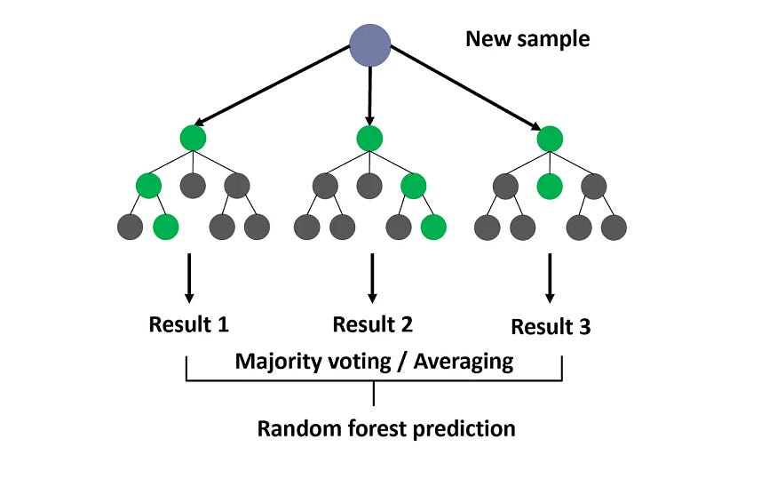
Random Forest Model
Why Random Forest?:
Delivered the strongest results across all evaluation metrics
Effectively balances Recall (capturing churners) and Precision (targeting the right accounts)
Performs well even on unseen data after tuning
Impact of Tuning
Tuning using GridSearchCV improved recall by ~5%, catching more churners
Small but impactful lift in all key performance metrics
Demonstrates excellent generalization and model stability

Slide 16
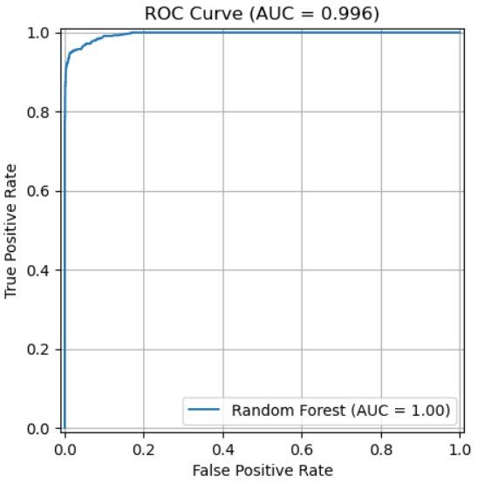
Tuning Results & Testing Scores
Hyperparameter | Description | Best Parameter
max_depth | Max levels in a tree — limits complexity | 20
min_samples_split | Minimum samples needed to split a node | 2
min_samples_leaf | Smallest sample count allowed at a leaf node | 1
n_estimators | Number of trees (in forests) — more trees = better averaging | 200
bootstrap | Whether to sample data with replacement | False
Metric | Base Model | Tuned Model
Accuracy | 97.19% | 97.99%
Recall | 84.74% | 89.30%
Precision | 98.37% | 98.64%
F1 Score | 91.05% | 93.74%
ROC AUC | 0.992 | 0.996

Slide 17
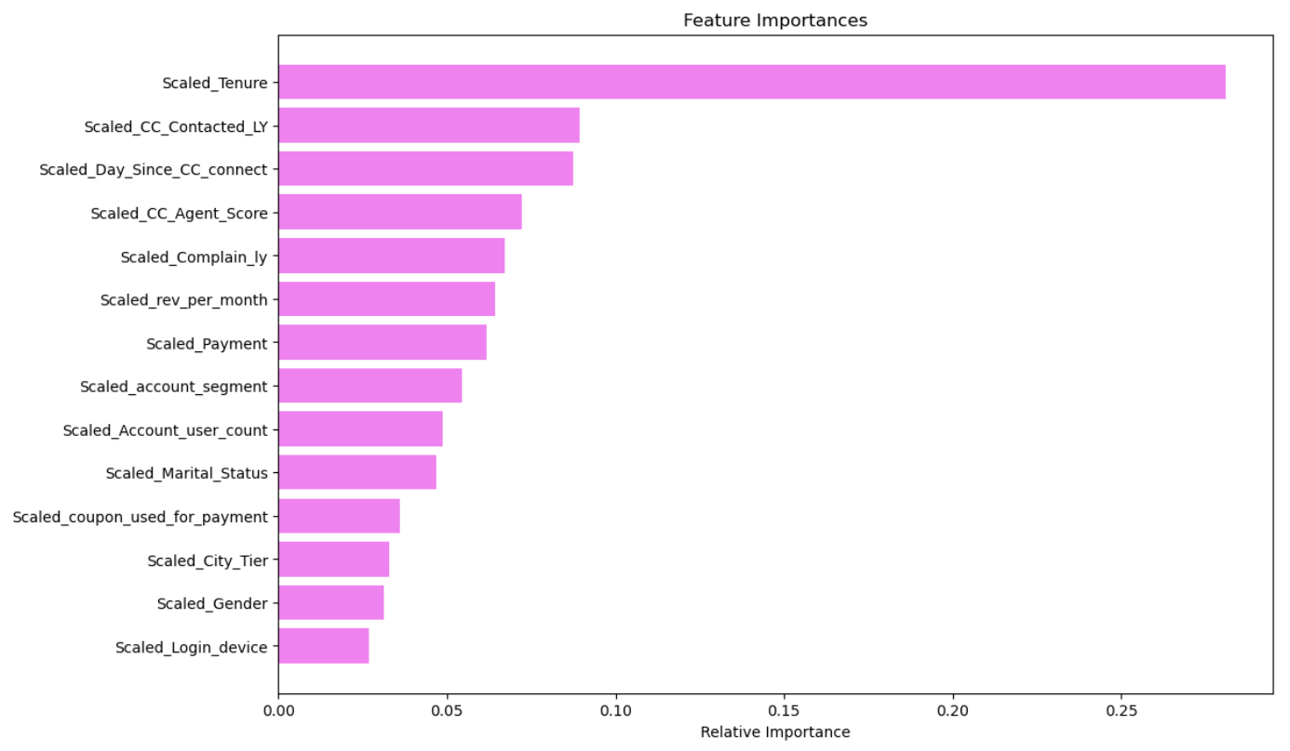
Feature Importances
Top Predictive Features:
Tenure
Customer Care Contacted in Last 12 Months
Day Since Customer Care Connect
Agent Score
Complaints in Last Year
These variables had the highest influence on the model's prediction outcome.
Low-Impact Features:
City Tier
Gender
Login Device
Coupon used for Payment

Slide 18
INSIGHTS & RECOMMENDATIONS

Slide 19
Insights
Early Tenure Risk: Churn is highest within the first 2 months — early engagement is critical.
Customer Support Experience Matters:
~61% of customers rated customer care ≤ 3
~78% of customers rated overall service ≤ 3
Pre-Churn Contact: Most churners interacted with support before leaving — opportunities to intervene were missed.
Retention Gaps Exist: Current programs aren't targeting early-stage or high-risk customers effectively.
Model Usability: High precision and recall allow for laser-focused retention efforts with minimal false positives.
Business Impact: Accurate churn prediction enables proactive strategies that reduce revenue loss and boost customer lifetime value.

Slide 20
Recommendations
Launch targeted onboarding and loyalty campaigns for customers in the first 2 months.
Improve agent training, response quality, and satisfaction tracking — especially for customers scoring service ≤ 3.
Monitor support interactions to flag potential churners early and trigger timely interventions.
Use model output to segment customers by churn likelihood and personalize offers, follow-ups, or win-back strategies.
Collect and analyze post-interaction feedback to fine-tune predictive accuracy and improve retention touchpoints.
Evaluate the relevance of current cashback and coupon initiatives in light of churn model findings, and develop targeted retention strategies if they no longer address high-risk customer segments effectively.

Slide 21
THANK YOU

